Slide 1
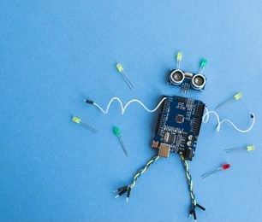
PHYS& 222 – Engineering Physics II Final Practicum Winter 2021 (2947)
Johnathan Chivington – AS-T II (Physics)
Sandesh Rai – AS-T II
Vasyl Kepynach – AS-T II

Slide 2

Goals
The objective of this project was to:
• Build a simulated circuit with a low-voltage analog sensor, calibrate and test it.
• Write code to run the sensor, and trigger actions at particular threshold temperatures.

Slide 3
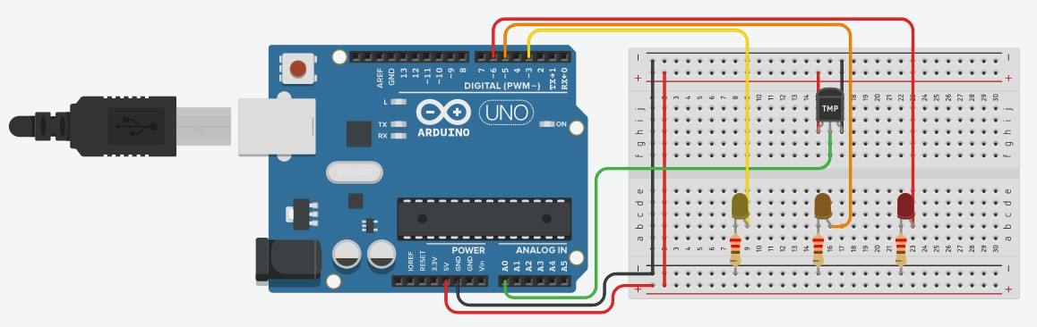
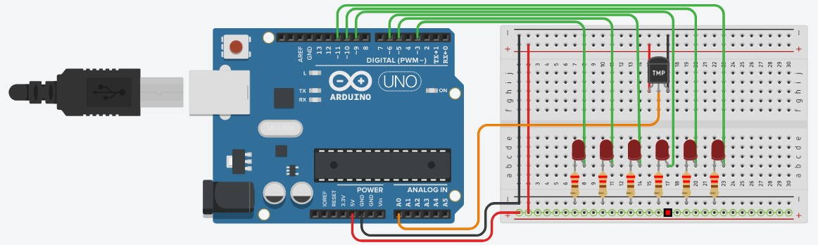




Schematic
Digital Circuit
Analog Circuit

Slide 4
Code – Overview
The control flow for this project consists of an initialization phase to set up serial communication and select the operating mode of the selected pins, followed by two routines:
a primary routine that runs continually, reading temperature values, displaying them to the serial console, and selecting the correct LEDs to light; and
a sub-routine that handles the LED selection for each temperature reading.
The following two slides detail the differences between the control flow in each project.

Slide 5
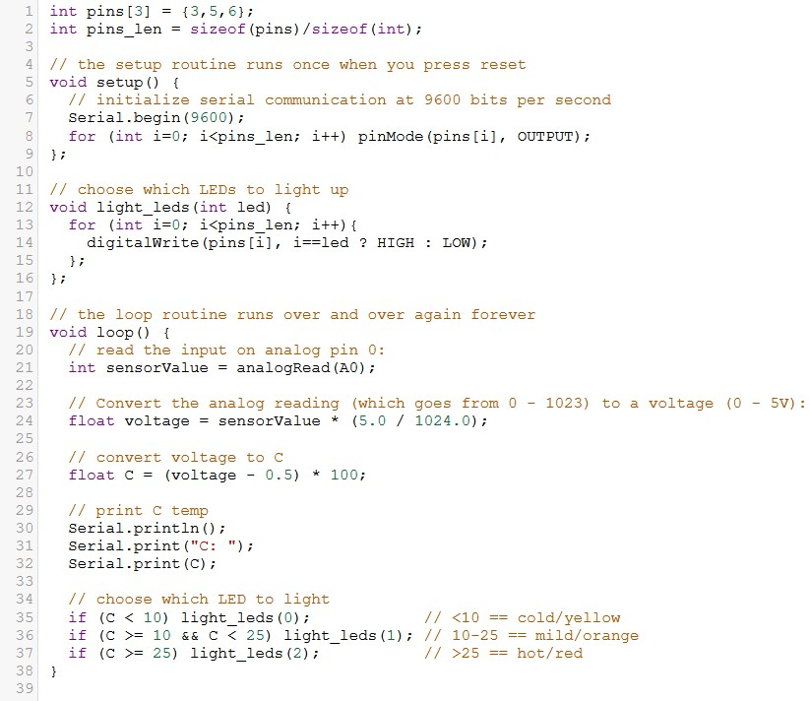
Code – Digital Thermometer
For the digital thermometer, the primary routine varies only at the end where it selects from one of three LEDs to light.
The sub-routine for this version selects one LED that corresponds to the temperature zone currently being read.

Slide 6
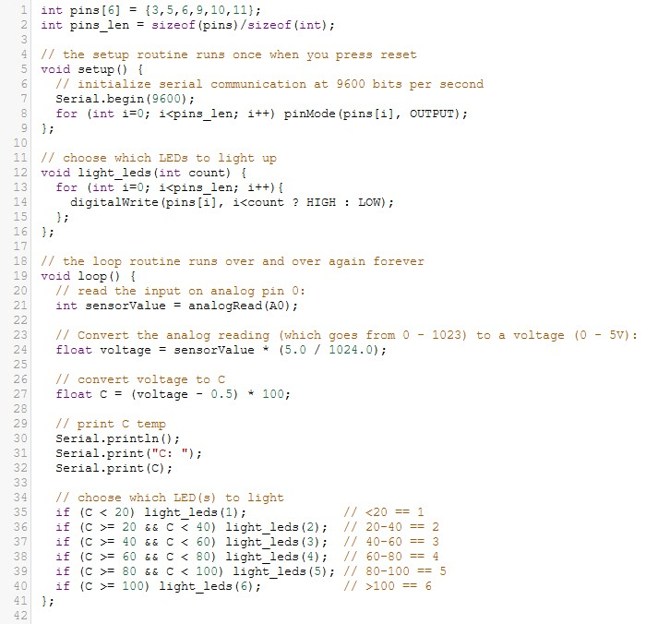
Code – Analog Thermometer
For the analog thermometer, the primary routine again varies only at the end where it selects multiple LEDs to light, instead of a single LED.
The sub-routine for this version selects the LEDs that corresponds to all temperature zones at and below the current value being read.

Slide 7
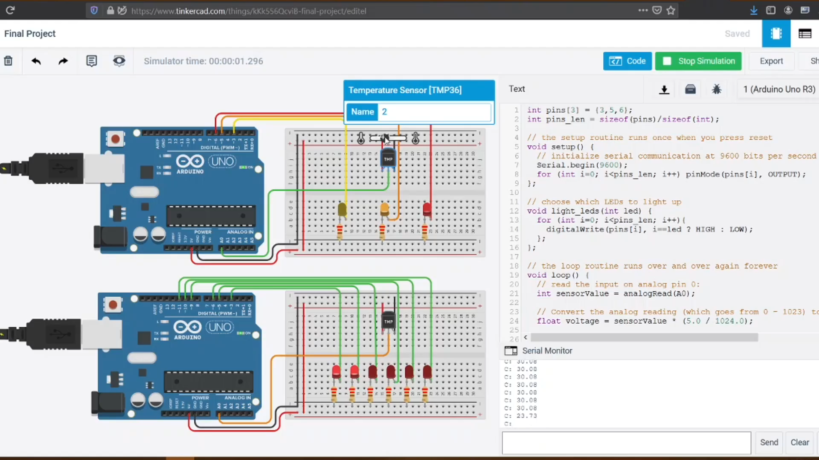
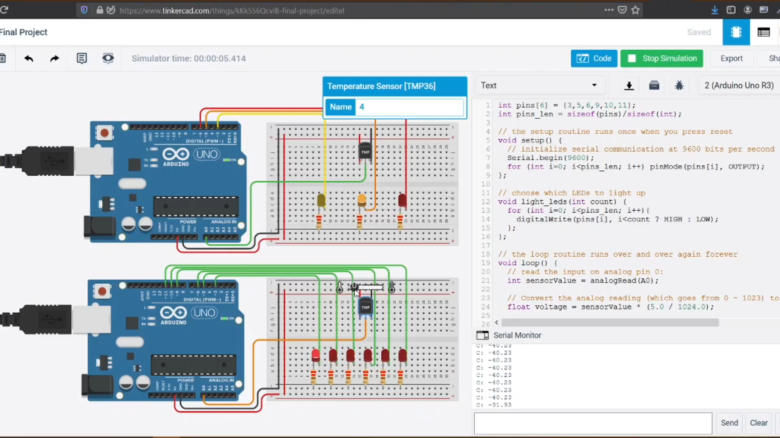
Results
Digital Circuit Demo
Analog Circuit Demo

Slide 8
Conclusion
As seen in the demonstrations, both circuits operate according to the required specifications:
Both continually read ambient temperature values from the TMP36.
The digital thermometer lights a single LED to indicate a specific “temperature zone.”
The analog thermometer lights multiple LEDs to indicate a “temperature level.”

